Slide 1
Machine Learning for Structural Health Monitoring
Prof. Kota Solomon Raju
Abhijay Kemkar - Prof. Amit Singh
Gitansh Pujari - Prof. Sundaresan Raman

Slide 2
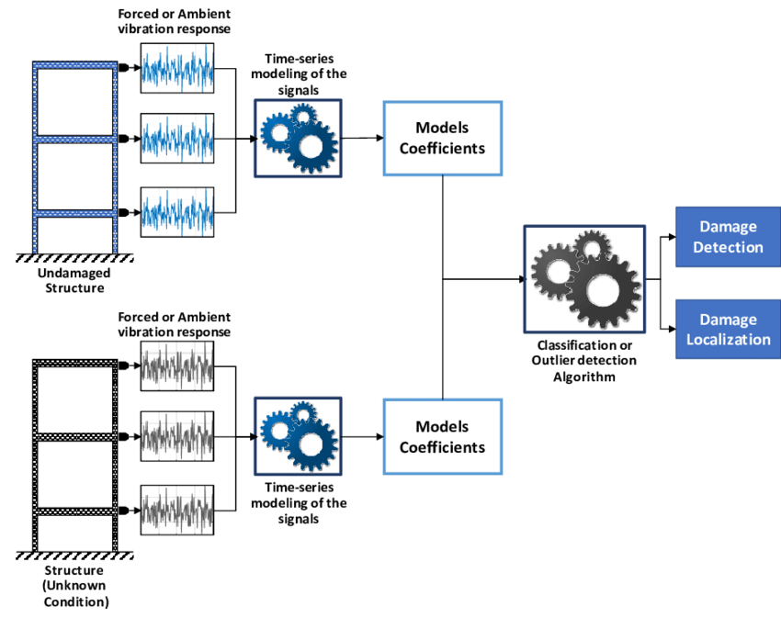
Application of the Subspace-Based Methods in Health Monitoring of Civil Structures
Subspace-based techniques in the vibration-based damage detection (VDD) of civil structures and is a promising field in SHM that assesses the health state of structures using vibration parameters.
Structures in VDD can be broadly divided into two categories: mechanical engineering structures and civil engineering structures.
Identification methods can be classified into two categories: incorporating input-output measurements and use unknown output measurements.
Output-only subspace system identification also referred as stochastic subspace identification (SSI)
Higher accuracy was achieved using the input-output approach as using input information provides more reliable results for modal identification.
Hoofar Shokravi, Hooman Shokravi, Norhisham Bakhary, Mahshid Heidarrezaei, Seyed Saeid Rahimian Koloor and Michal Petru : 22 May 2020
Notes:
Subspace system identification aims to establish a mathematical model for resolving practical problems in various science and technology branches.
ME and CE structures are usually subjected to different loading and boundary conditions.
The input-output algorithm is still an attractive choice for earthquake-induced excitation.

Slide 3
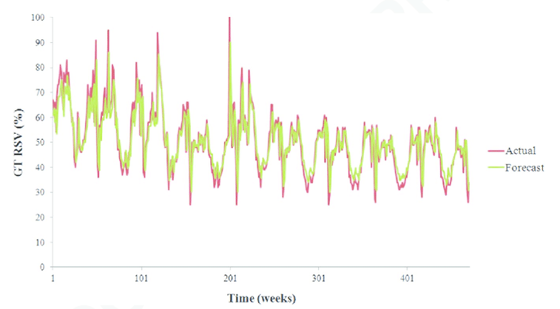
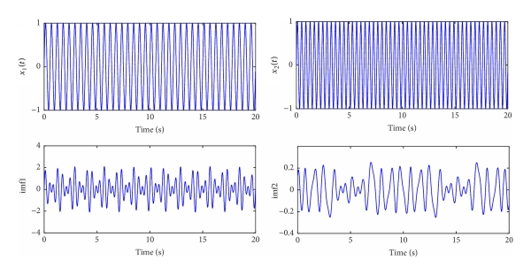
Application of the Subspace-Based Methods in Health Monitoring of Civil Structures
SSI Data
Data-driven stochastic subspace identification (SSI-DATA) efficacy of three different excitation signals of impact, excellent agreement with estimated modal frequencies of more robust modes and less accurate results were reported for damping ratios.
A combined subspace system identification method is generally applied in modal analysis and the health monitoring of seismic-excited civil structures.
The subspace system identification is a more suitable choice for modal identification of closely spaced modal frequencies.
Comparison among ERA, and ARMA techniques, subspace
system identification has provided the most accurate results
Hoofar Shokravi, Hooman Shokravi, Norhisham Bakhary, Mahshid Heidarrezaei, Seyed Saeid Rahimian Koloor and Michal Petru : 22 May 2020
Notes:
In the statistical analysis of time series, autoregressive–moving-average (ARMA)

Slide 4
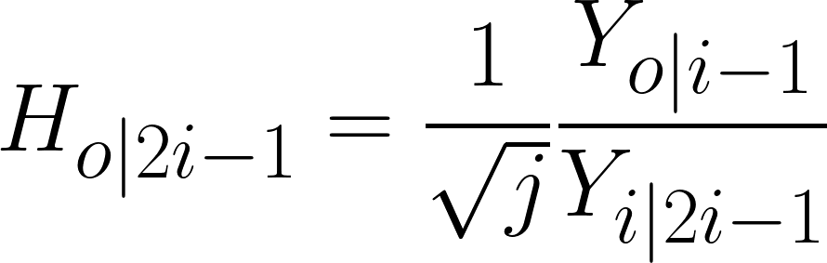
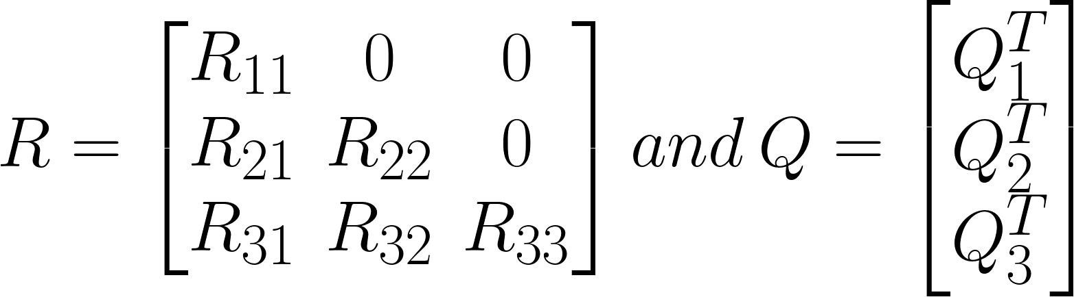
Application of the Subspace-Based Methods in Health Monitoring of Civil Structures
Algorithm
Firstly the Henkel block matrix is constructed from the measured vibration sensor data as
Then the QR Decomposition of the matrix H into a product QR of an orthogonal matrix Q and an upper triangular matrix R is performed as:
Projection maps/matrices are the vector of response values to the vector of fitted values are defined based in the obtained decomposition as:
Hoofar Shokravi, Hooman Shokravi, Norhisham Bakhary, Mahshid Heidarrezaei, Seyed Saeid Rahimian Koloor and Michal Petru : 22 May 2020
Notes:
SSI DATA Technique: Not suitable for complex data categories with a large number of sensors, large number of modes of interest, and existing turbulence or non-stationarity.
where i and j are the number of rows and columns and Y is the measured data value.

Slide 5
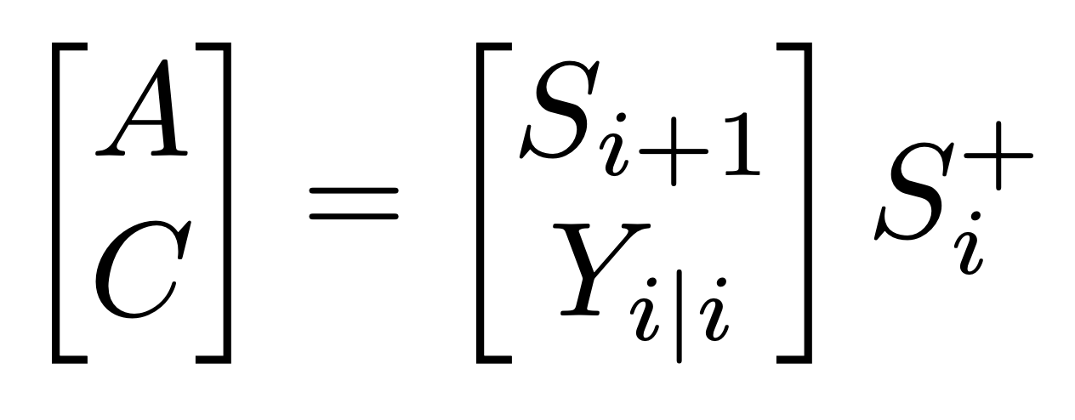
Application of the Subspace-Based Methods in Health Monitoring of Civil Structures
By calculating the Singular value decomposition of the Projection Matrix, which is a factorization of the form UZV, where U is an mxm real unitary matrix, Z is an mxn rectangular diagonal matrix with non-negative real numbers on the diagonal, and V is an non real unitary matrix gives:
P_{i} =UΣV^{T}
By factorization of the P matrix, the Kalman filter state sequence S = O_{i}⁺P_{i} and observability matrix O_{i} = UZ₁/2V^{T} can be obtained by the formula P_{i} = O_{i}S_{i}.O_{i}⁺ generating the Moore-Penrose pseudo inverse of O. Using similar factorization of the P_{i} and S_{i}, the one step projection P_{i−1} and Kalman state sequence S_{i+1} can be calculated as:
S_{i+1} = [O_{i}⁺]⁺P_{i}
Solving the least squares for the state space matrix A and output matrix C yields:
Hoofar Shokravi, Hooman Shokravi, Norhisham Bakhary, Mahshid Heidarrezaei, Seyed Saeid Rahimian Koloor and Michal Petru : 22 May 2020
Notes:
The Moore-Penrose pseudo inverse is a generalization of the matrix inverse when the matrix may not be invertible, given by A⁺ = A^{T}· (A · A ^{T}) ⁻¹

Slide 6
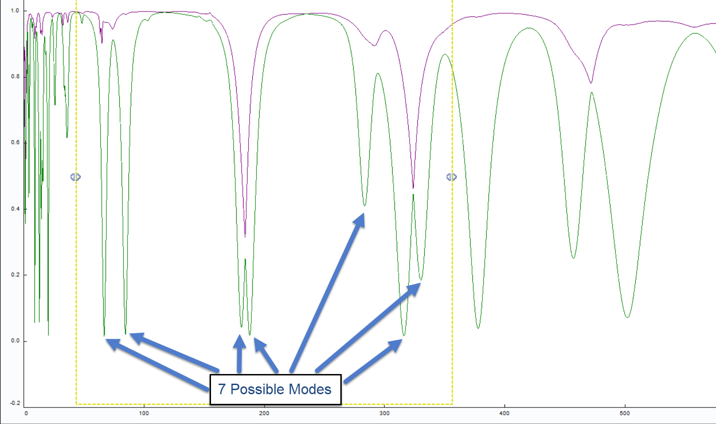
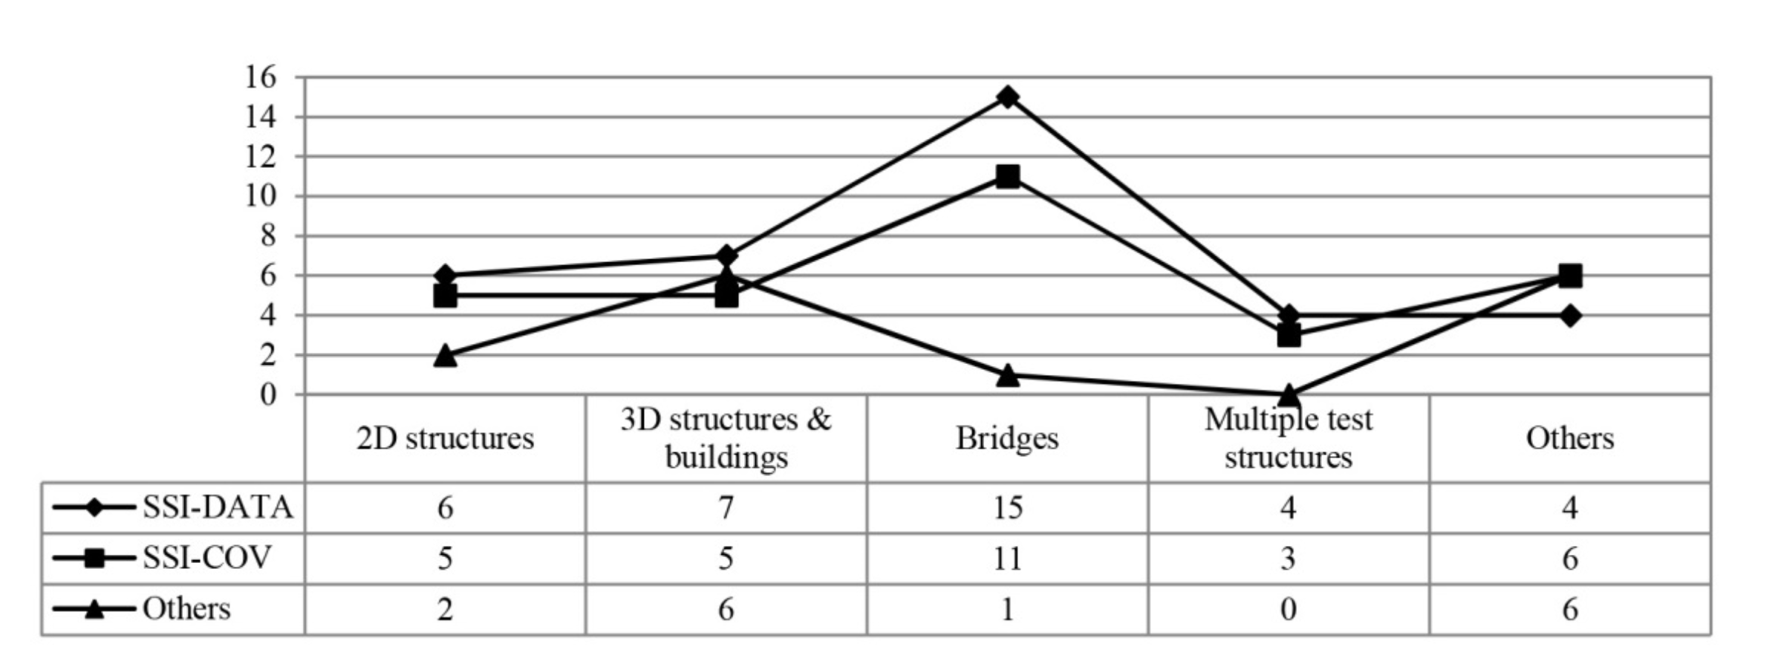
Application of the Subspace-Based Methods in Health Monitoring of Civil Structures
Improved efficiency was achieved by adopting a stabilization diagram on identified modal parameters using SSI-COV and SSI-DATA techniques.
Reference-based generalization (SSI-data/ref, SSI/ref, and CSI/ref) are adopted in the software package. OMA, LMS Cada-X, LMS International, TestLab are used for modal analysis.
Particle swarm optimization (PSO) with a sequential Niche technique (SNT) was used for the FE model updating of a pedestrian cable-stayed bridge.
Singular spectrum analysis (SSA) was adopted to smoothen input signal and yield reliable modal parameters as a preprocessing tool for SSI-COV.
Several algorithms are introduced based on classical SSI-COV, SSI-DATA, and the combined method to improve the subspace system's performance. The obtained results for SSI-DATA and SSI-COV algorithms are similar in the case of accuracy, but the computation time SSI-COV is much lower than the SSI-DATA.
Hoofar Shokravi, Hooman Shokravi, Norhisham Bakhary, Mahshid Heidarrezaei, Seyed Saeid Rahimian Koloor and Michal Petru : 22 May 2020
Notes:
Stabilization diagram provides a graphical representation of the system's poles (modes) at different mode orders during the modal parameter identification stage.
"singular spectrum analysis" relates to the spectrum of eigenvalues in a singular value decomposition of a covariance matrix,

Slide 7
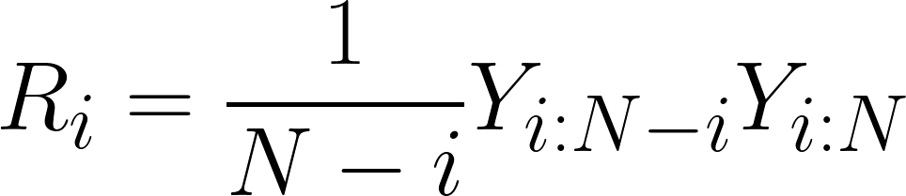
Application of the Subspace-Based Methods in Health Monitoring of Civil Structures
Algorithm
SSI-COV Method used hierarchical clustering to identify natural frequencies of each mode of data obtained from the optical sensors.
The correlation matrix given below is a table showing correlation coefficients between variables. Each cell in the table shows the correlation between two variables. For our data, it is calculated at i time lags in N number of sensor data where Y_{i:N-i} and Y_{i:N} are the data matrix after removing the last and first i block rows, respectively.
The correlation matrix for each sets of time lag is estimated and gathered into T_{1|i} namely block Toeplitz matrix or diagonal-constant matrix. Furthermore the one-lag shifted Toeplitz matrix T_{2|i+1} is also calculated. Then, the estimated correlation is decomposed into orthogonal matrices U and V together with using SVD again as the SSI Data approach as:
T_{1|i} = U_{i}ΣV₁^{T}
Hoofar Shokravi, Hooman Shokravi, Norhisham Bakhary, Mahshid Heidarrezaei, Seyed Saeid Rahimian Koloor and Michal Petru : 22 May 2020
Notes:
Toeplitz matrix or diagonal-constant matrix.
observability is a measure of how well internal states of a system can be inferred from knowledge of its external outputs.

Slide 8
Application of the Subspace-Based Methods in Health Monitoring of Civil Structures
The state matrix is obtained by multiplication of the Observability matrix which is a measure of how well internal states of a system can be inferred from knowledge of its external outputs with the reversed controllability matrix as:
By splitting the T_{1|i} matrix using identity matrix yields:
O_{i}=U₁Σ₁^{1/2}I^{T} and Γ_{i}=I⁻¹Σ₁^{1/2}I^{T}
By factorization of the one-lag shifted Toplitz matrix and solving the state space matrix yields:
A = Σ₁^{1/2}U₁TT_{2|i+1}V¹Σ₁^{1/2}I^{T}
Hoofar Shokravi, Hooman Shokravi, Norhisham Bakhary, Mahshid Heidarrezaei, Seyed Saeid Rahimian Koloor and Michal Petru : 22 May 2020
Notes:
matrix decomposition or matrix factorization is a factorization of a matrix into a product of matrices.

Slide 9
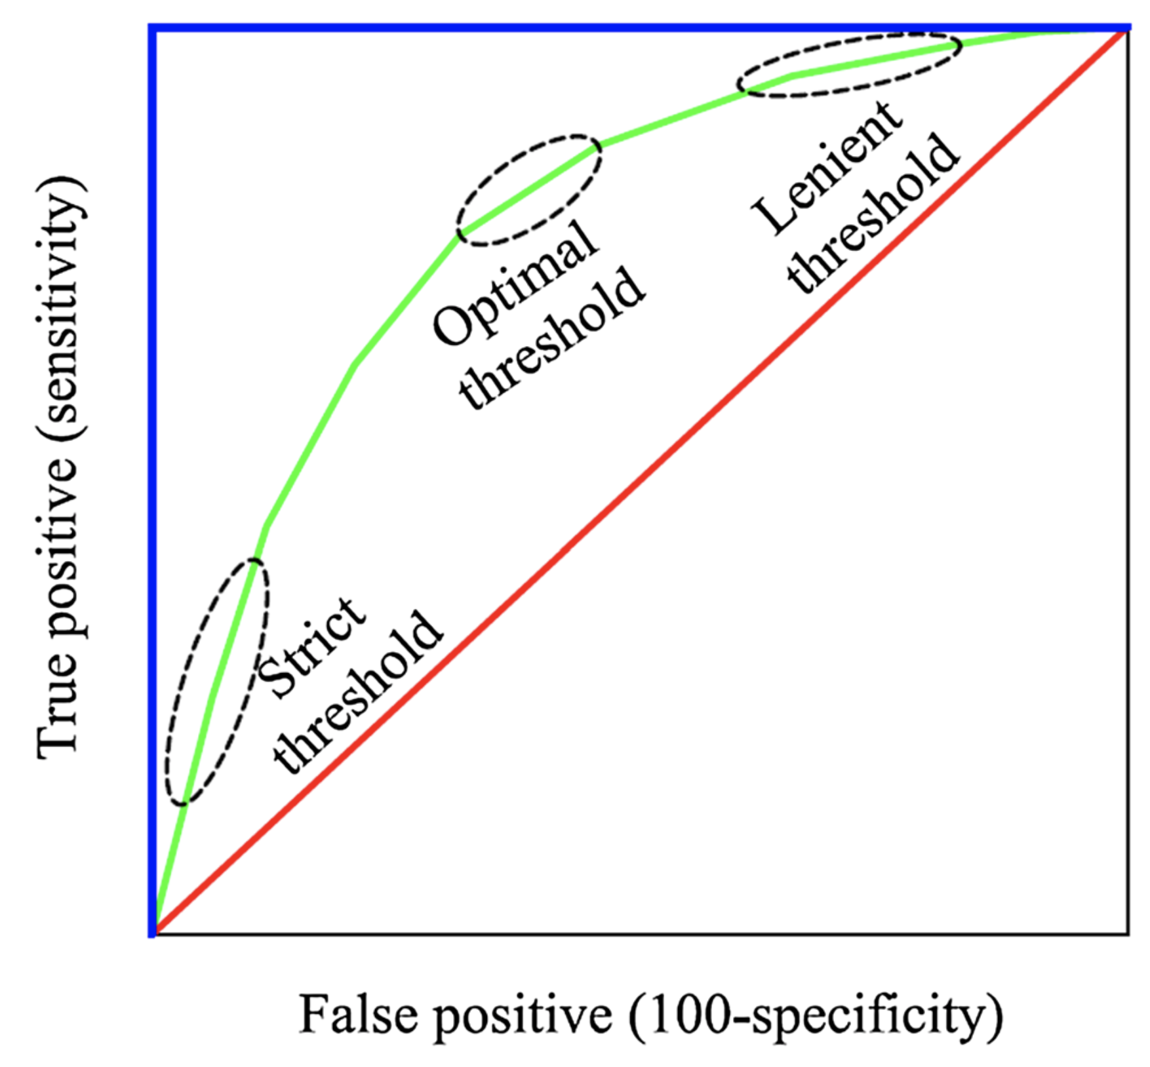
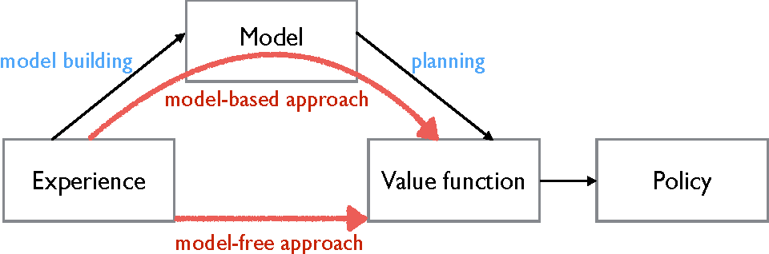
Structural health monitoring of bridges: a model-free ANN-based approach to damage detection
SHM is divided into a model-based and model-free.
Simulations of train passages behave in normal (one baseline model) and abnormal conditions (two damaged models). Based on the acceleration values at previous instants in time, the networks can predict future accelerations. Secondly, each network's acceleration prediction errors are statistically characterized by a Gaussian process that supports the choice of a damage detection threshold and then can point out damage on the bridge.
Optimal sensor placement is a crucial part of any damage detection system.
Artificial neural networks are used as outlier or novelty detection methods that provide a qualitative indication of damage in the structure without prior knowledge of how the system behaves when damaged.
A ROC curve is a two-dimensional graph in which the true positive rate is plotted against the false-positive rate for a given threshold. The costs related to false negatives are the most penalizing.
A. C. Neves1 • I. Gonza ́lez2 • J. Leander1 • R. Karoumi1 : 6 November 2017
Notes:
finite element model of the target structure, damage detected has a direct physical interpretation
consists of training an algorithm on some acquired data and can tell apart different condition states of the structure

Slide 10
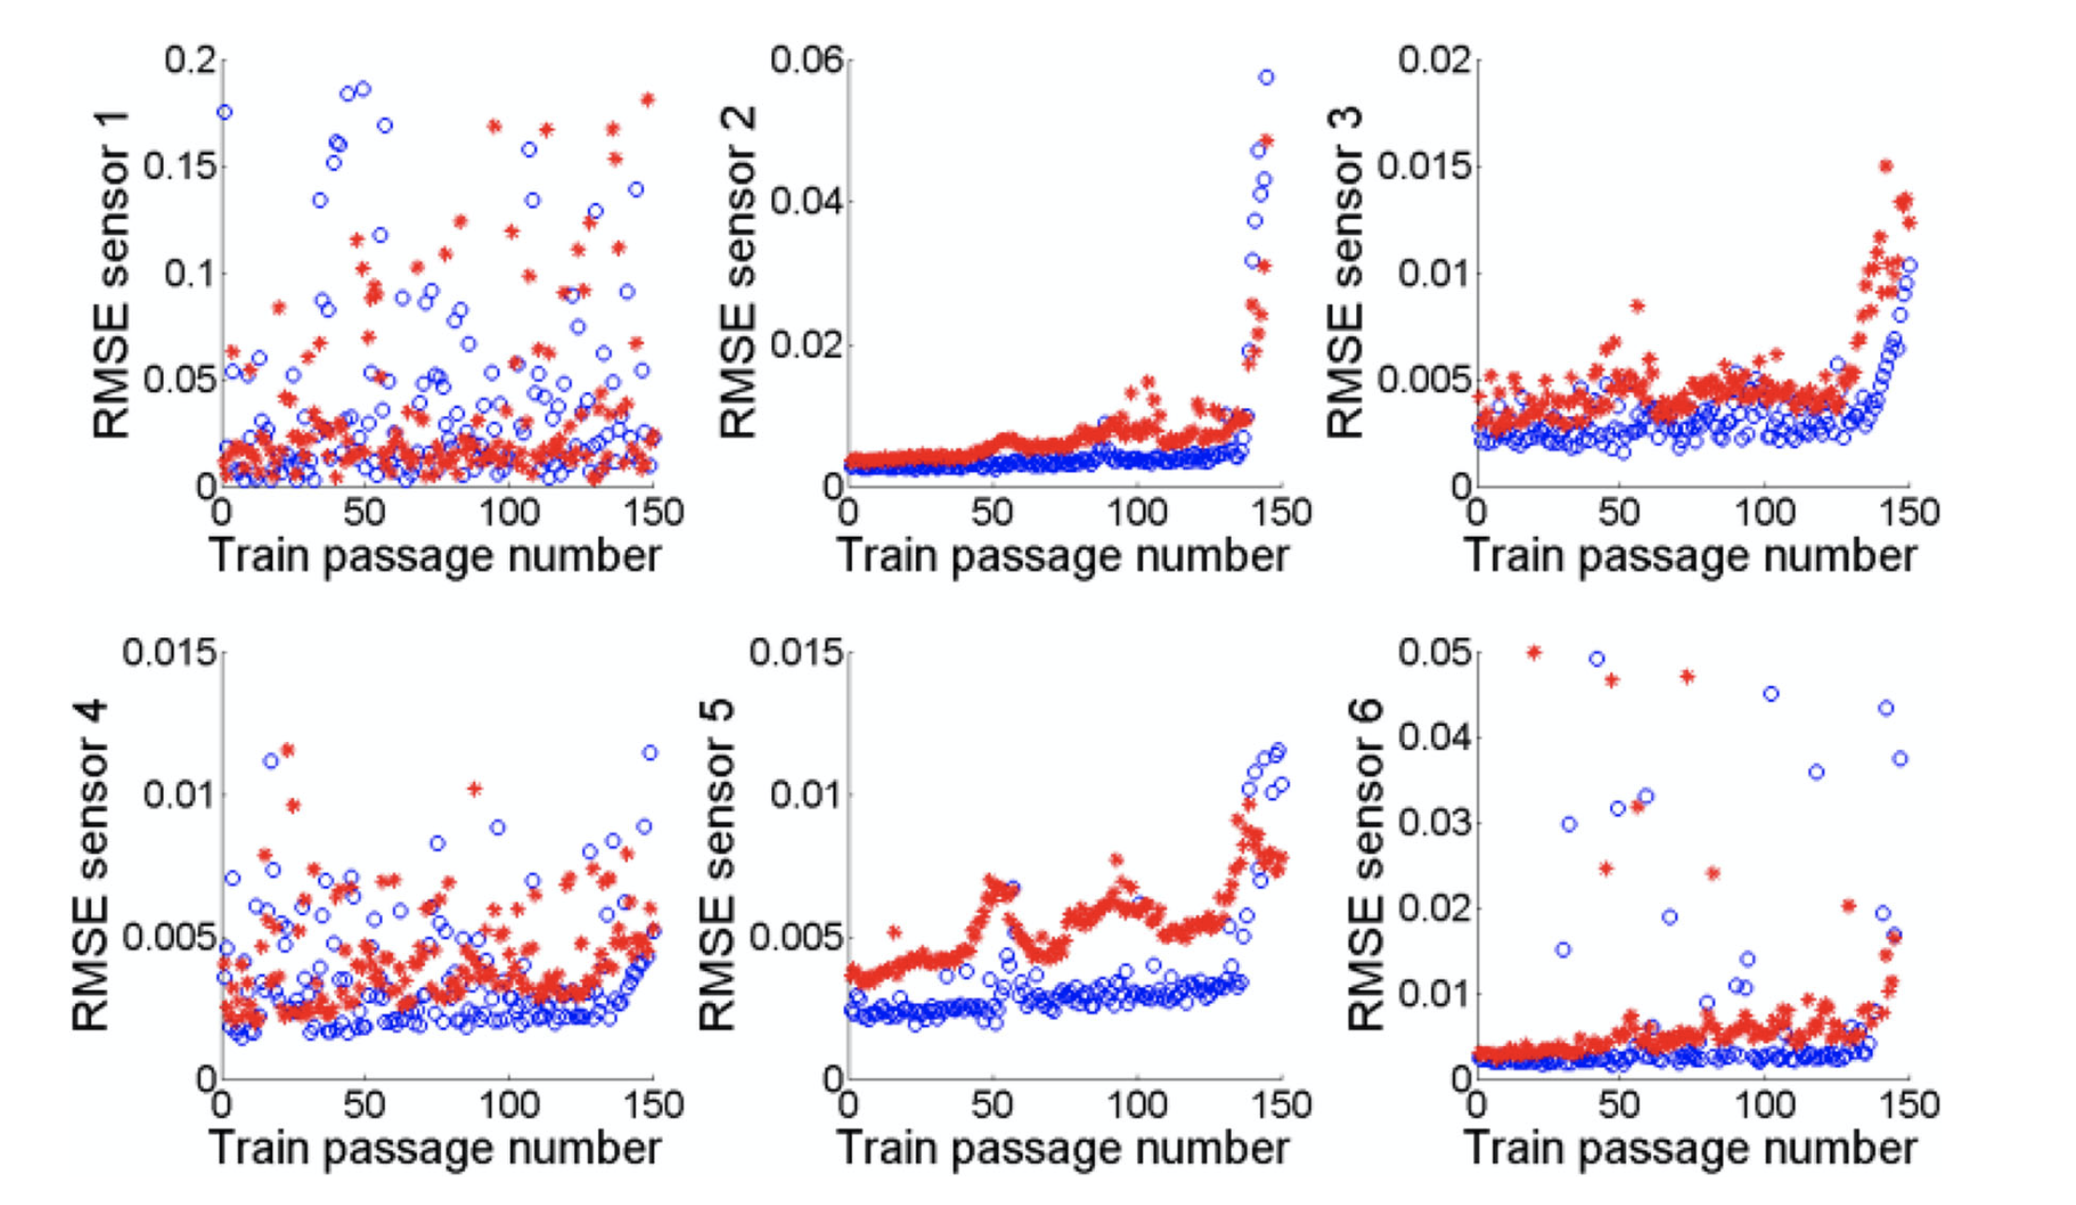
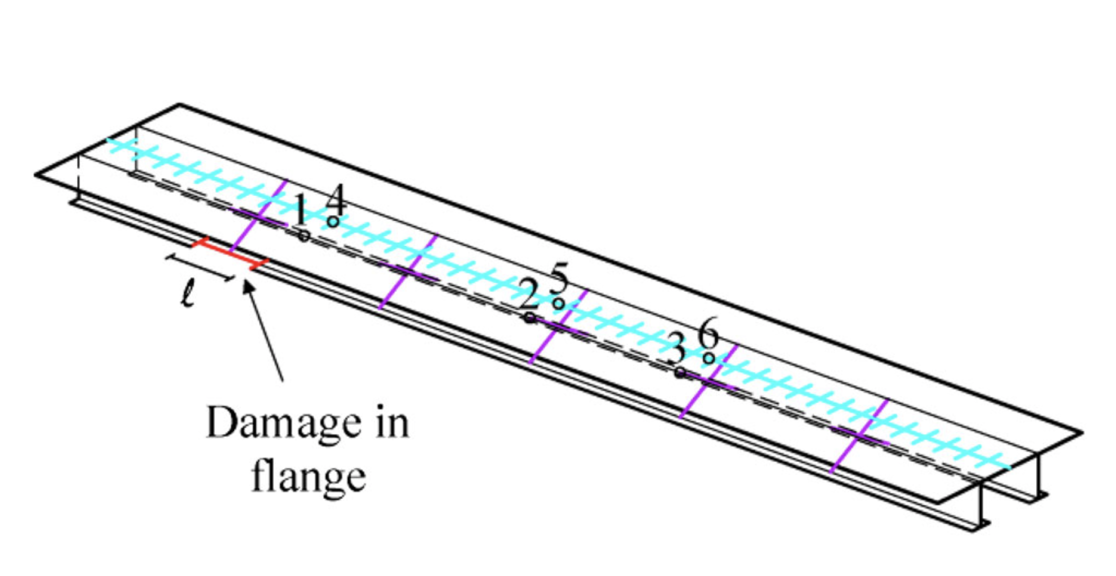
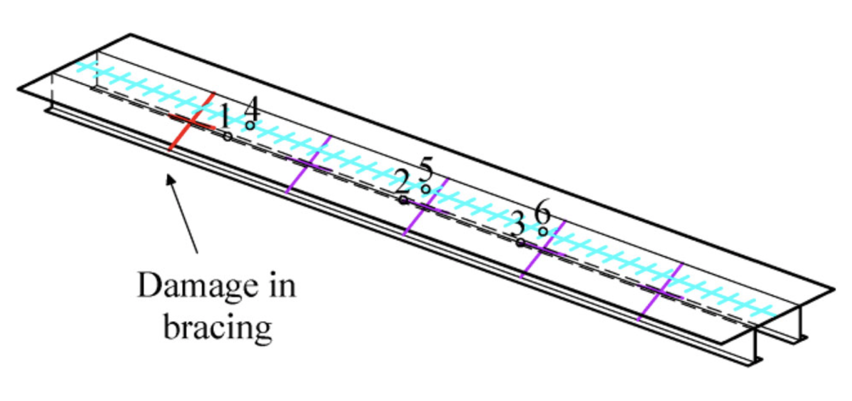
Structural health monitoring of bridges: a model-free ANN-based approach to damage detection
3D finite element model of a single-track railway bridge was developed using FEM software ABAQUS. Traffic-induced vibration was obtained by simulating 300 passages of a train. The train model was based on the HSLM-A4.
150 train passages were used to train the network, and the 150 remaining ones were used for testing and validation of the trained network along with Gaussian white noise with a constant standard deviation of 0.0005 m/s2. Different groups of ANNs trained using Levenberg–Marquardt backpropagation algorithm, with each group having six different networks predicting for one of the six sensors.
49 input neurons: the number of neurons equals the number of features, which are the 30 accelerations ant􏰁i registered by the 6 sensors in the last 5 samplings, the 18 axle loads and 1 axle position relative to a reference point. 30 neurons for the hidden layer. 1 output neuron: the current acceleration ant at time t predicted by sensor n.
Sensors situated closer to the bridge's geometric middle yield a better separation between structural states, while sensors placed near the end supports are not as efficient in this task.
A. C. Neves1 • I. Gonza ́lez2 • J. Leander1 • R. Karoumi1 : 6 November 2017

Slide 11
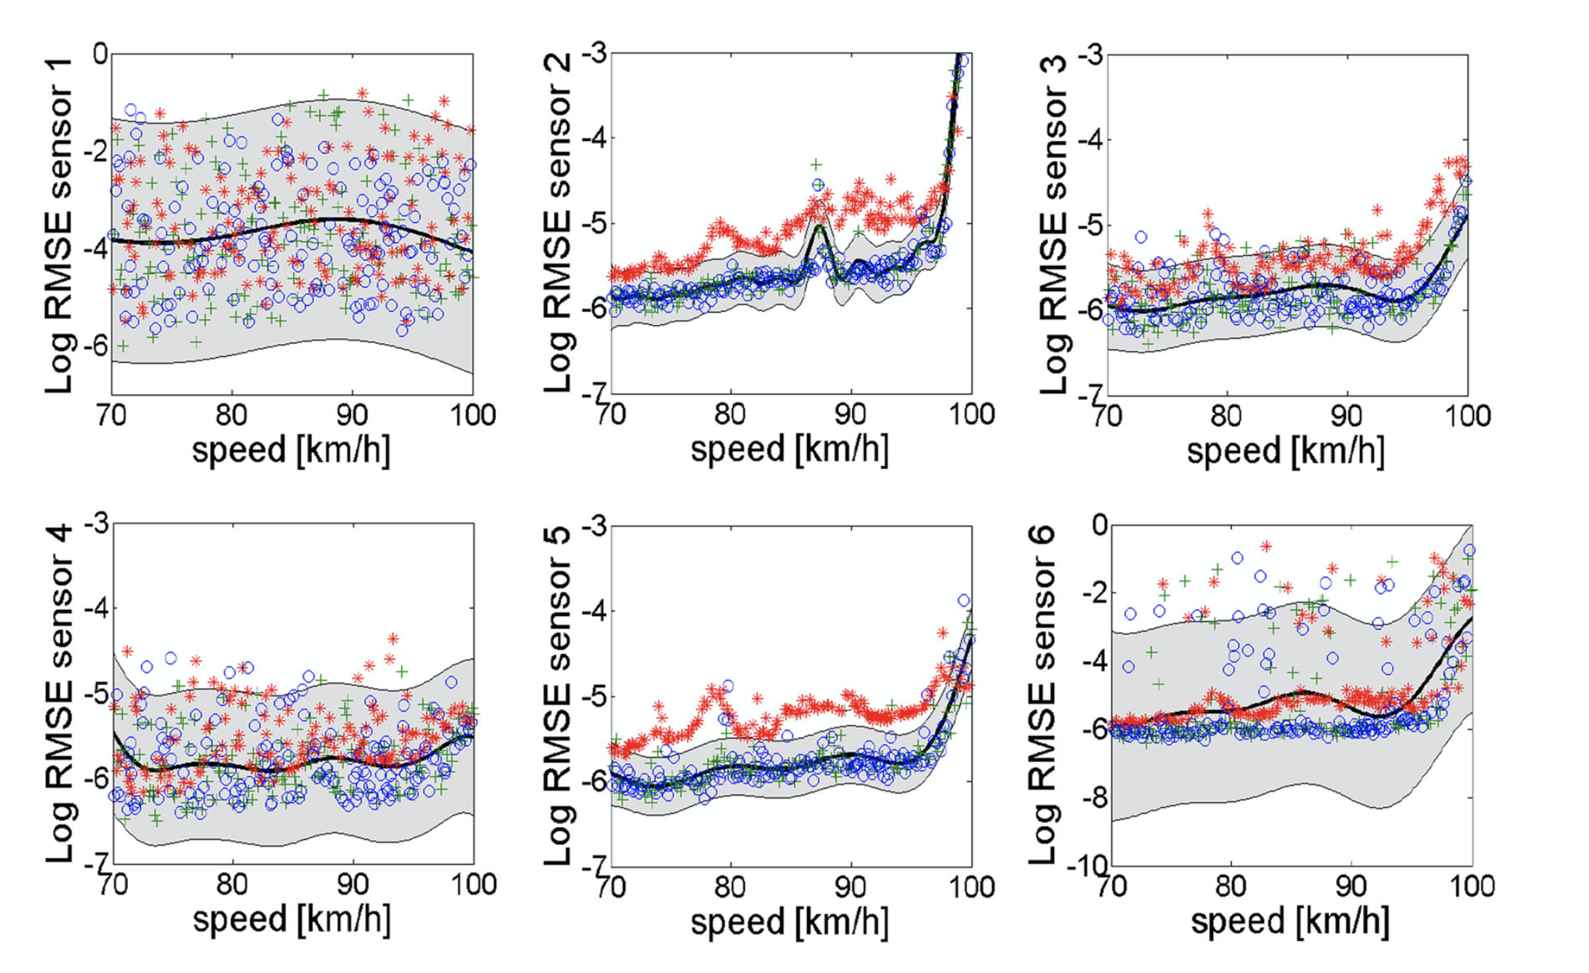
Structural health monitoring of bridges: a model-free ANN-based approach to damage detection
Associated predicted errors are normally distributed, and the mean and standard deviation of the error is recorded.
Regarding future research, once the damage is detected, a subsequent step could be to study the correlation between measurements acquired from the sensing system's different devices, in an attempt to pinpoint the location of the damage. At the same time, optimal sensor placement could be carried out for the system to identify damage in a sufficiently accurate manner while avoiding redundancy in the information.
A. C. Neves1 • I. Gonza ́lez2 • J. Leander1 • R. Karoumi1 : 6 November 2017

Slide 12
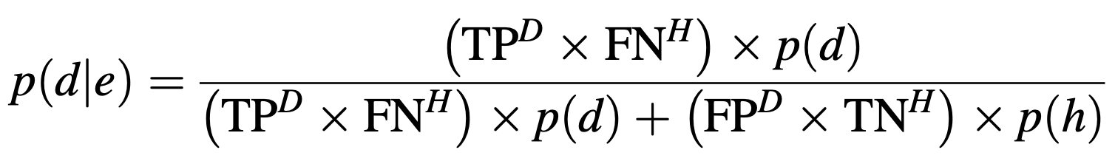
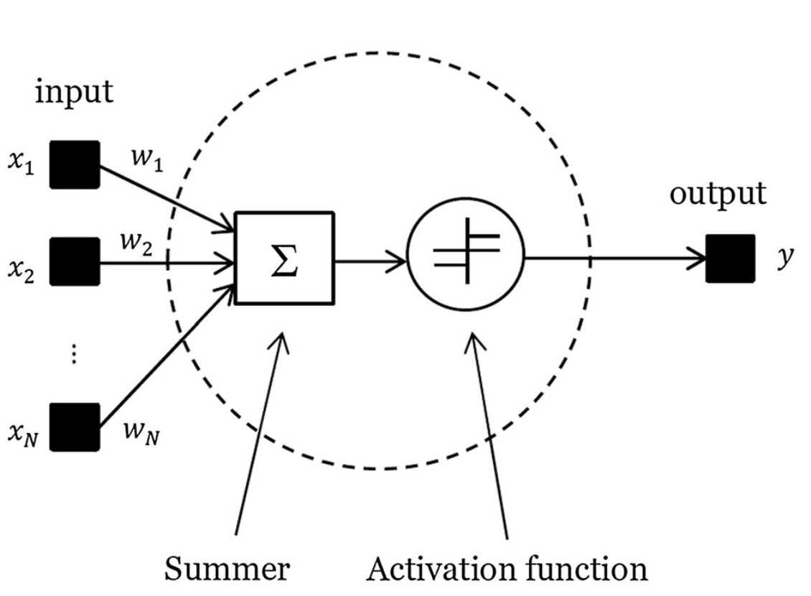
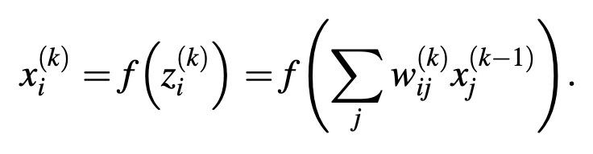
Structural health monitoring of bridges: a model-free ANN-based approach to damage detection
How ANN works: Probability calculation for Bayes Theorem
Each node i is connected to each node j in the previous and following layers over a connection of weight wij. In layer k, a weighted sum is performed at each node i of all the signals from the preceding layer k 1, giving the j excitation of the node; this sum is then passed through a nonlinear activation function f to emerge as the output of the node to the next layer
A. C. Neves1 • I. Gonza ́lez2 • J. Leander1 • R. Karoumi1 : 6 November 2017

Slide 13
Machine-learning-based approach for post event assessment of damage in a turn-of-the-century building structure
This study include support vector machines, neural networks, and Gaussian Naive Bayes techniques for training of the structural health monitoring model.
The structural model is trained with the input data as the change in strain magnitudes under known loading configurations.
The stiffness equation of the structural system is F = KU where, F is the load matrix, K is the stiffness matrix, and U is the displacement matrix,
Change in strain due to loads is written as V= V^{d}-V^{u} , where, V^{d} ={𝜀_{1,d}|𝜀_{2,d}|......|𝜀_{n,d}| }^{T} and V^{u} ={𝜀_{1,u}|𝜀_{2,u}|......|𝜀_{n,u}| }^{T} are strain vectors for damaged and undamaged states, respectively. 𝜀_{i,d} and 𝜀_{i,u} are the strains at location t due to load F_{i} in damaged and undamaged states, respectively.
The vector V is used as input to the ML models which is used to interpret structural damage and will be employed to predict the damage for conditions that the structure was previously never exposed to.
Ebrahim Nazarian1 • Todd Taylor1 • Tian Weifeng1 • Farhad Ansari1 : 20 February 2018
Notes:
(after point 2) Once the model has been trained, it will be employed to predict the damage for any other loading conditions that the structure was previously never exposed to.
(point 3) For the structural components of the building, such as beams, columns and walls, damage is defined as the change in their stiffness.

Slide 14
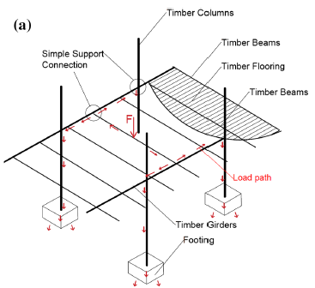
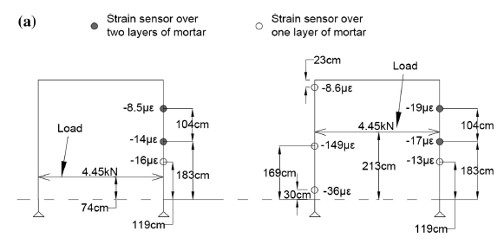
Experimental Setup
Machine-learning-based approach for post event assessment of damage in a turn-of-the-century building structure
𝜀_{m}h_{m}+ 𝜀_{b}(h_{s}-h_{m}) = h_{s}𝜀_{s}
Where,
𝜀_{m}=𝜎_{s}/E_{m}
𝜀_{b} =𝜎_{s}/E_{b}
The thickness of the mortar layer and the FBG sensor are known, the modulus of elasticity of the mortar and brick assembly was obtained.
Elongation of the brick and mortar assembly due to the bending strain is equivalent to the elongation of the sensor
𝜀_{m} is the strain in the mortar, 𝜀_{b} is the strain in the brick, h_{m} is the thickness of the mortar, h_{s} is the gauge length of the sensor, 𝜀_{s} is strain output of the sensor and 𝜎_{s} is the average stress along the sensor’s gauge length. h_{m} and h_{s} were directly measured. 𝜎_{s} was determined by applying the loading pattern that was employed in the finite element model and obtaining the average stress at the location of strain sensor.
Ebrahim Nazarian1 • Todd Taylor1 • Tian Weifeng1 • Farhad Ansari1 : 20 February 2018

Slide 15

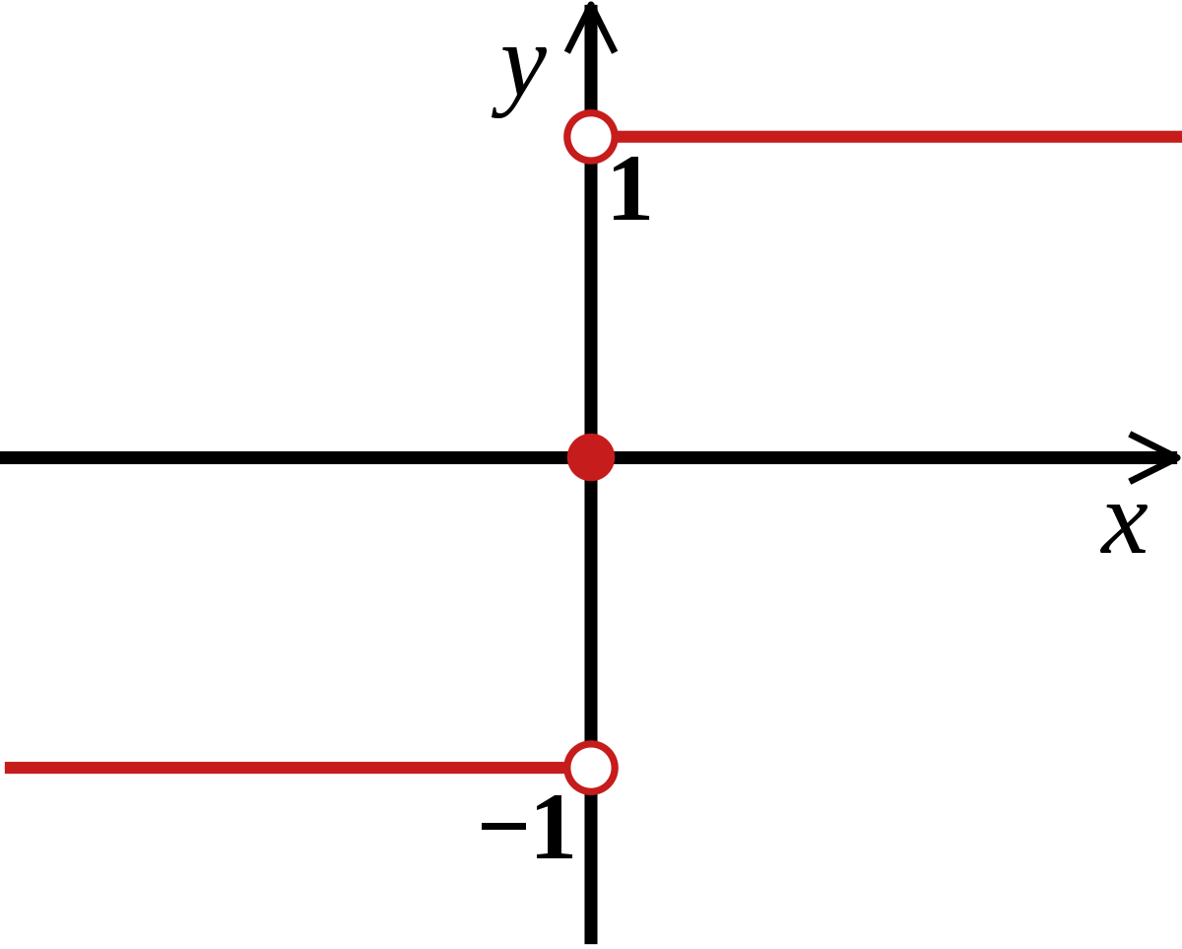
Support vector machine:
Machine-learning-based approach for post event assessment of damage in a turn-of-the-century building structure
The hyperplane decision boundary for strain vector, V, can be written as f(V) = sign((W^{T})ɸ(V) + b) where sign is the signum function, b is the bias and phi is a mapping function. We use f(V) to classify a new data point V .
Maximal margin hyperplane between the strain vectors is obtained when W = Σ^{n}_{i=1}α_{i}y_{i}𝛗(V_{i}) where n is the number of the possible damage cases used in training, y is the binary output which defines the damage case that a strain vector belongs to, and alpha i are positive coefficients that maximize the following equation
𝚺^{n}_{i=1}α_{i} - 𝚺^{n}_{i,j}α_{i}α_{j}y_{i}y_{j}𝛗(V_{i})^{T}𝛗(V_{j}) such that Σ^{n}_{i=1}α_{i} y_{i} =0
Ebrahim Nazarian1 • Todd Taylor1 • Tian Weifeng1 • Farhad Ansari1 : 20 February 2018
Notes:
(start) Strain vectors are separated with a maximal margin and Margin is defined as the distance between the closest strain vectors to the hyperplane
(point 2) Hyper planes separate the strain vectors such that the two sides of a hyperplane, represent two different damage case scenarios.
(last point) Overfitting was prevented using penalty coefficients and monitoring the accuracy in test data.

Slide 16
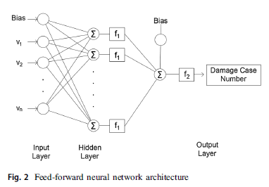
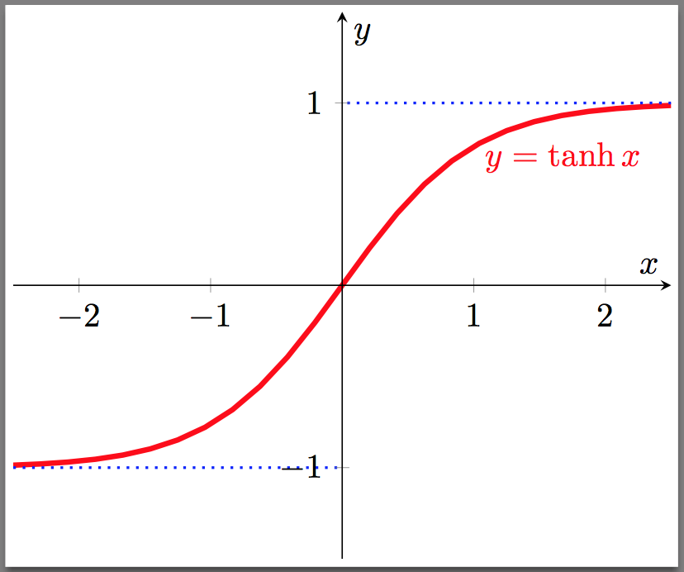
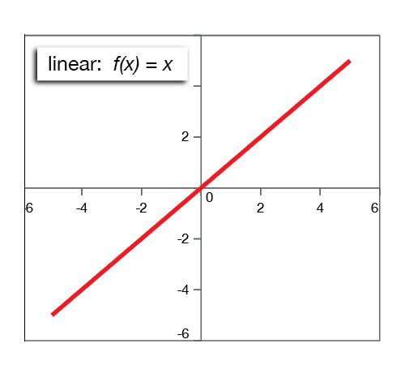
Neural Networks
Machine-learning-based approach for post event assessment of damage in a turn-of-the-century building structure
Neural network that we are using is multi-layer feed-forward network. This network consists of input layer, hidden layer(s) and output layer.
Input layer pertains to strain vector, V, output layer pertains to damage case number and about 100 nodes were used in hidden layer. f1 is the hyperbolic tangent function and f2 is a linear activation function.
The intensity of damage was computed with relative errors, NN provided the best results and SVM yielded larger errors. SVM predicted the structural damage with a maximum relative error of 11%.
Ebrahim Nazarian1 • Todd Taylor1 • Tian Weifeng1 • Farhad Ansari1 : 20 February 2018
Notes:
The relationship between the layers is then determined by back propagation algorithm and gradient descent to achieve the correct damage case number for a given training input.

Slide 17
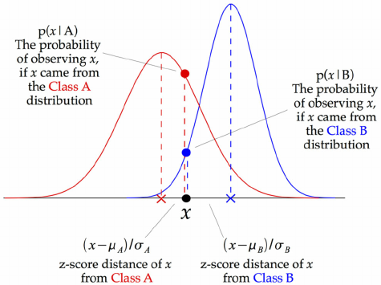
Gaussian Naive Bayes:
Machine-learning-based approach for post event assessment of damage in a turn-of-the-century building structure
Gaussian Naive Bayes (NB) is a statistical approach based on probabilities and Bayes theorem.
GNB estimates the probability for all possible damage cases. The damage case that has the highest probability is then considered to be the predicted damage case.
Conditional probability of the damage case di for a given set of sensors data can be written as P(d_{i}/X) = P(V/d_{i})P(d_{i})/P(V) where V is the strain vector and P() is the probability function. Since the output is independent we can write: P(V/d_{i}) =𝚷_{t}P(v_{t}/d_{i}), where P(v_{t}/d_{i}) is normally distributed. The predicted damage case, d, is then obtained by d = argmax_{i} P(d_{i}/X), where argmax is arguments of maxima which pertains to the damage case, i, that maximizes the function P(d_{i}/X).
P(X_{i}/Y_{j}) = e^{-(xi - μj )^2/2σj^2}/√2πσ_{j}² ,where μ_{j} is mean of class j and σ_{j} is variance of class j.
Ebrahim Nazarian1 • Todd Taylor1 • Tian Weifeng1 • Farhad Ansari1 : 20 February 2018

Slide 18
Machine learning techniques for structural health monitoring
This paper reports on an embedded machine learning approach for decentralized, autonomous sensor fault detection in wireless sensor networks which is based on the principle of analytical redundancy, which enhances the reliability and accuracy of SHM systems.
Two general approaches exist for assessing the structural condition are physics-based approaches and data-driven approaches.
Data-driven approaches are particularly useful when
(i) large quantities of sensor data are available.
(ii) the physical characteristics of the structure are complex to model
(iii) the computational efforts are to be reduced
Data-driven models exploit information from previously collected sensor data, referred to as “training data”.
Sensor faults and miscalibrations substantially affect sensor data and may compromise the reliability and accuracy of SHM specifically in data-driven approaches,
Kay SMARSLY, Kosmas DRAGOS and Jens WIGGENBROCK : 8 July 2016
Notes:
(after 1 point) Instead of physically installing multiple sensors for measuring one single parameter, analytical redundancy takes advantage of the redundant information inherent in the SHM system and utilizes the coherences and relationships between the sensors installed in the structure.

Slide 19
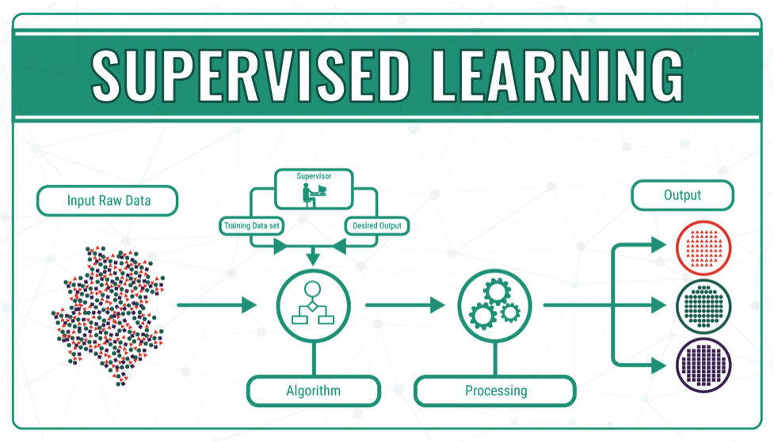
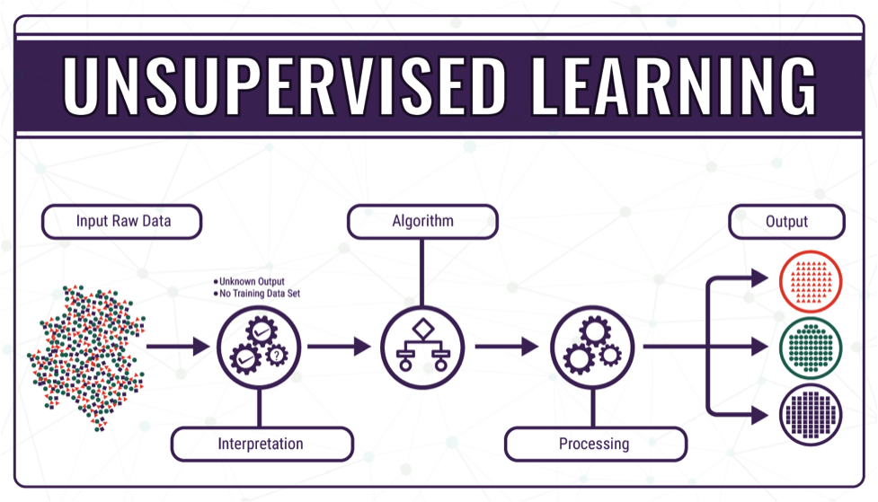
Machine learning techniques for structural health monitoring
Machine learning techniques can be classified as:
(i) Supervised learning which provides a learning scheme with “labeled data”, It is used for identifying the type and severity of damage (SVM, naive Bayes classifiers, and feed- forward NN).
(ii) Unsupervised learning encompasses the detection of patterns within the data sets consisting of “unlabeled data”, i.e. data sets with unspecified outputs .It is used for identifying the existence and location of damage (k-means and self-organizing maps).
Kay SMARSLY, Kosmas DRAGOS and Jens WIGGENBROCK : 8 July 2016

Slide 20
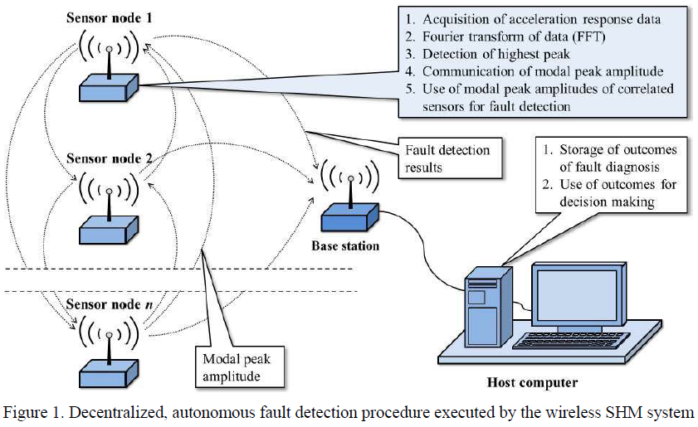
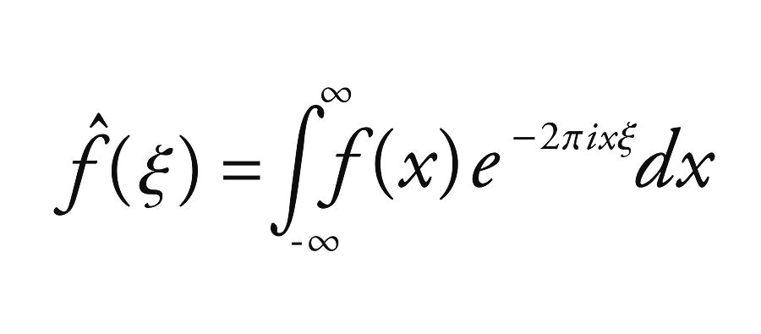
Implementation
Machine learning techniques for structural health monitoring
The peak amplitudes of the frequency spectrum, obtained by the Fourier transformation of acceleration response data are correlated.
The correlation can be exploited to predict the modal peak amplitudes of selected sensors, using the modal peak amplitudes of correlated sensors as input data.
Deviations between expected amplitudes and actual amplitudes (i.e. from the measured data) are indicative of sensor faults and miscalibrations.
A wireless SHM system is designed that comprises wireless sensor nodes, each of which including an integrated 3-axis accelerometer, a base station, and a host computer.
Kay SMARSLY, Kosmas DRAGOS and Jens WIGGENBROCK : 8 July 2016
Notes:
During operation, acceleration response data is sampled by each sensor node and locally transformed into the frequency domain via an algorithm.
A peak detection algorithm selects the highest peak of the frequency spectrum corresponding to the fundamental eigenfrequency
During operation, acceleration response data is sampled by each sensor node and locally transformed into the frequency domain via an embedded algorithm

Slide 21
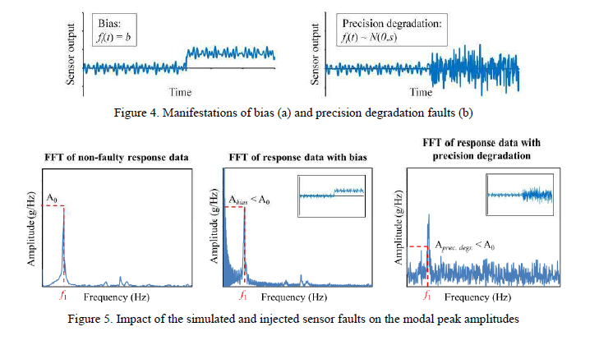
App. of Autonomous fault Detection
Machine learning techniques for structural health monitoring
Kay SMARSLY, Kosmas DRAGOS and Jens WIGGENBROCK : 8 July 2016
Notes:
Two of the most common fault types, bias and precision degradation, are simulated and injected into the acceleration response data.
A bias is a deviation between the actual response and the expected response by a constant value; precision degradation is a contamination of the response data with excessive-variance noise.
Bias is injected by rotating one sensor node by 45o, while precision degradation is injected by contaminating the acceleration response data of the sensor nodes with a random Gaussian time series.

